Slide 1
File Processing
Guoqiang Zhang

Slide 2
File types
Text files:
Generally contains human readable characters
Binary files:
Generally not limited to human readable characters
Python create a file object to process files
Check https://docs.python.org/3/tutorial/inputoutput.html for detailed information

Slide 3
Opening and Closing Files: Approach (1)
Opening files using the built-in function open
Syntax
file_object = open( file_name, mode)
mode option | Meaning
'r' | Open for reading from a text file (default)
'w' | Open for writing to a text file, truncating (overwriting) the file first
'rb' or 'wb' | Open in binary mode (read/write using byte data)
Closing a file after opening it
file_object = open(’textfile’, ‘r’)
file_object.close()

Slide 4
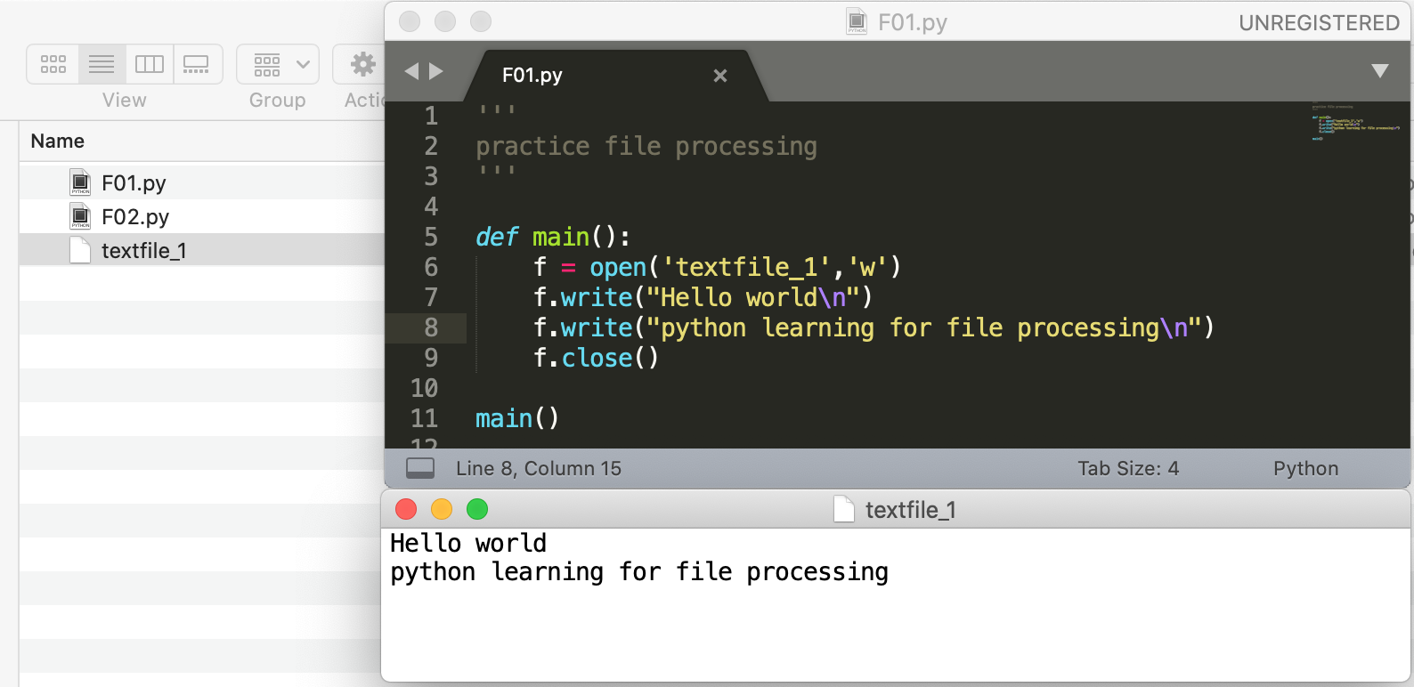
Opening and Closing Files: Approach (1)
A sample code:

Slide 5
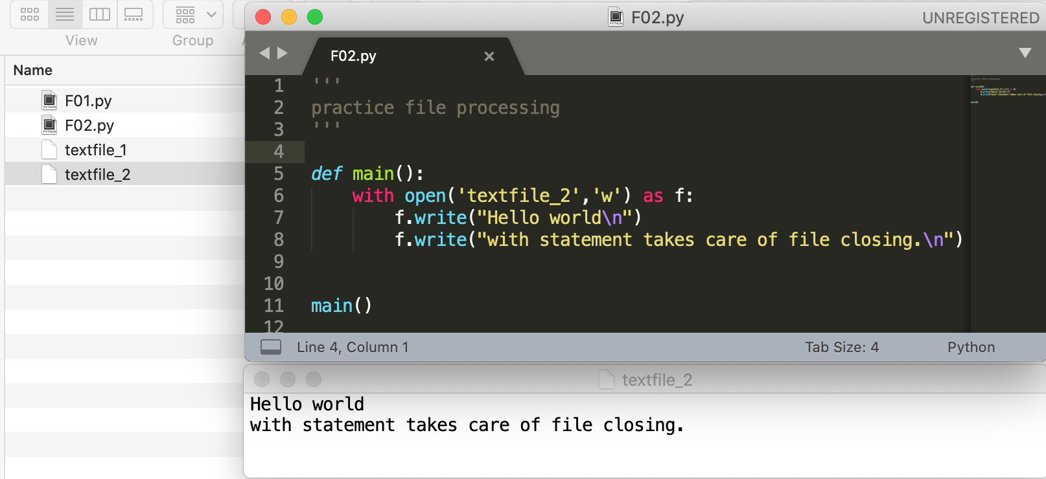
Opening and Closing Files: Approach (2)
Opening a file using ”with statement”
with open(file_name, mode) as file:
code block for file processing
The ”with statement” automatically takes care of closing the file once it leaves the with block

Slide 6
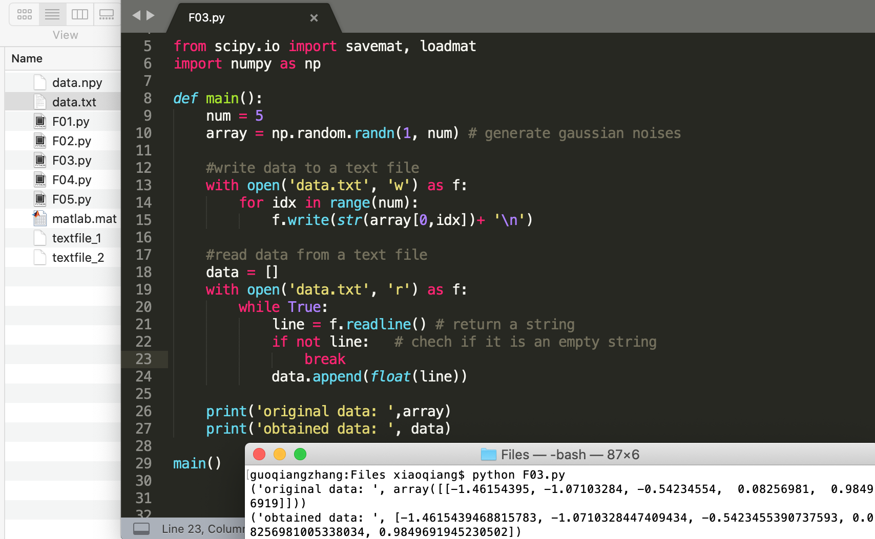
Opening and Closing Files: Approach (2)
A sample code

Slide 7
Processing .npy files
.npy files are for storing data in the format of numpy data structures
The package numpy provides predefined functions to process .npy files
numpy.save(file_name, data)
Save data to a .npy file.
numpy.load(file_name)
Load data from a .npy file.
Resources: check https://numpy.org/doc/stable/reference/generated/numpy.save.html
https://towardsdatascience.com/what-is-npy-files-and-why-you-should-use-them-603373c78883
for detailed information

Slide 8
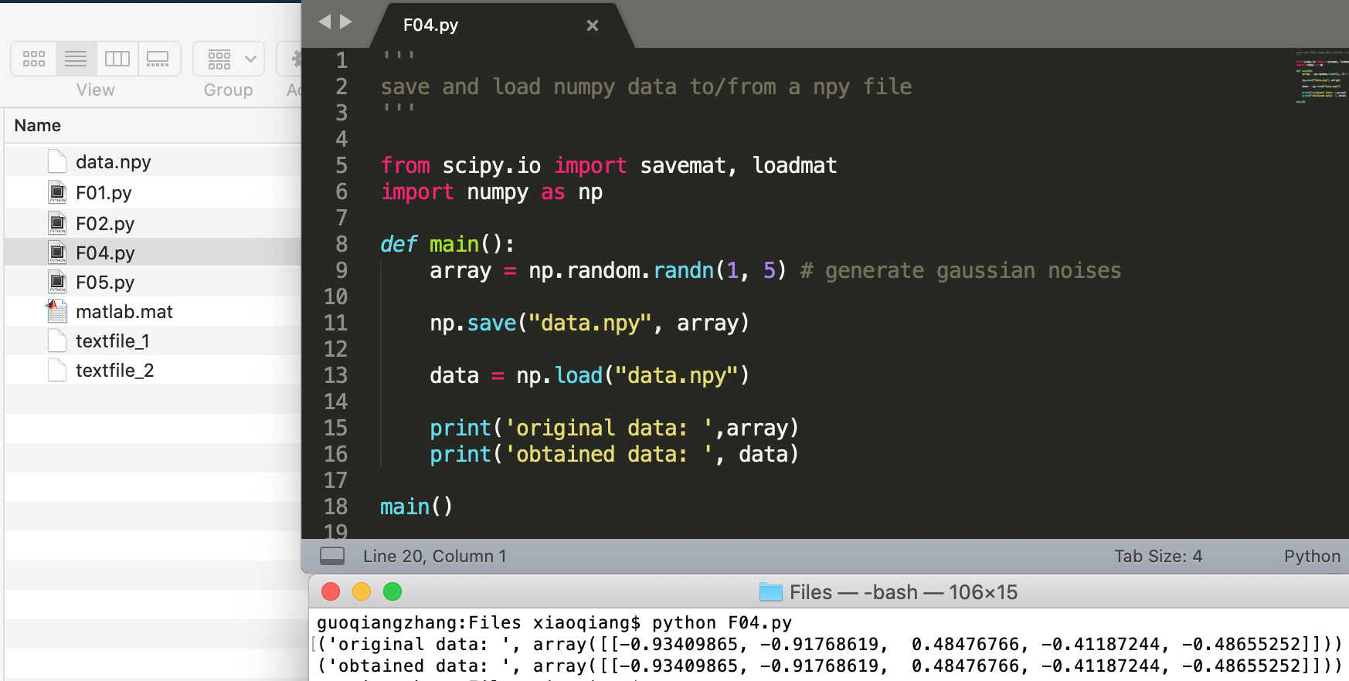
Processing .npy files
A sample code

Slide 9
Processing matlab files
The package scipy provides predefined functions to process matlab files
scipy.io.savemat
Save a dictionary of names and arrays into a MATLAB-style .mat file.
scipy.io.loadmat
A function to load data from a matlab file
Resources: check https://docs.scipy.org/doc/scipy/reference/generated/scipy.io.savemat.html
for detailed information

Slide 10
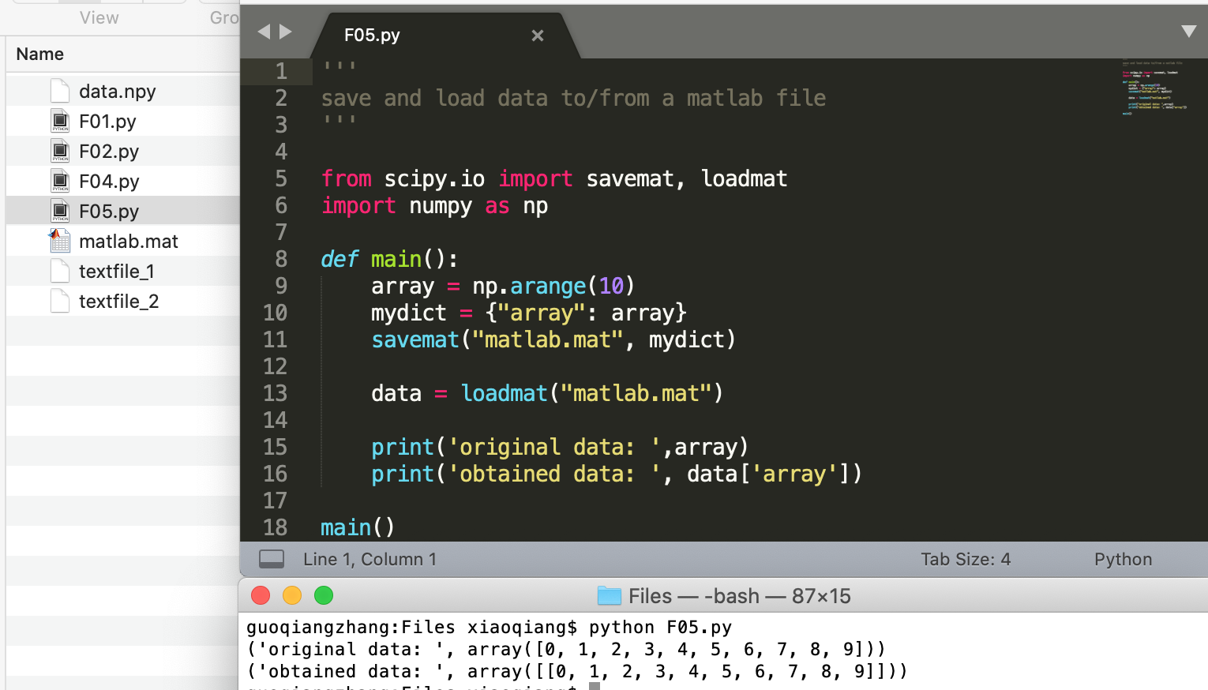
Processing matlab files
A sample code

